Slide 1
IT JOB FORUM

Slide 2
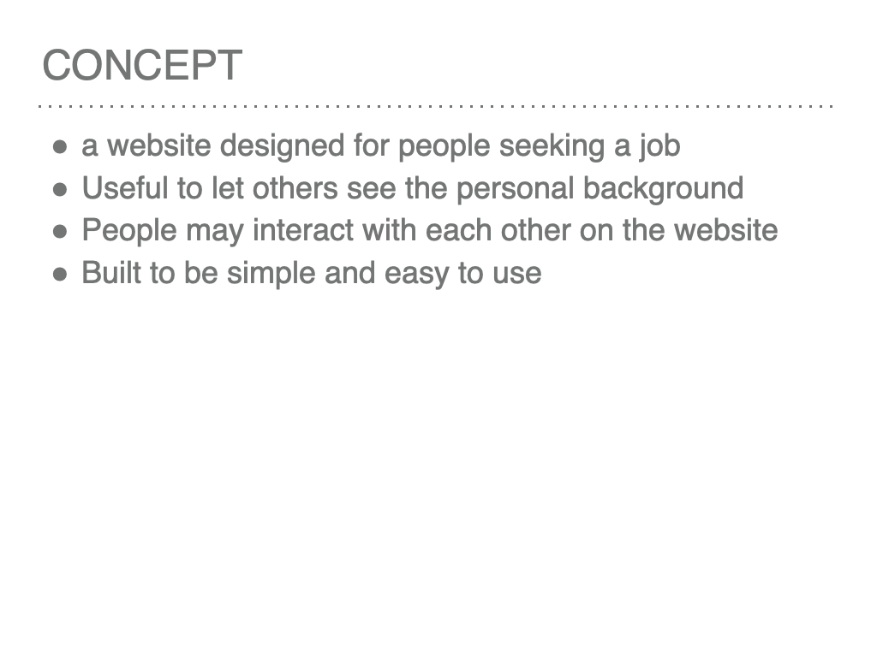

Slide 3
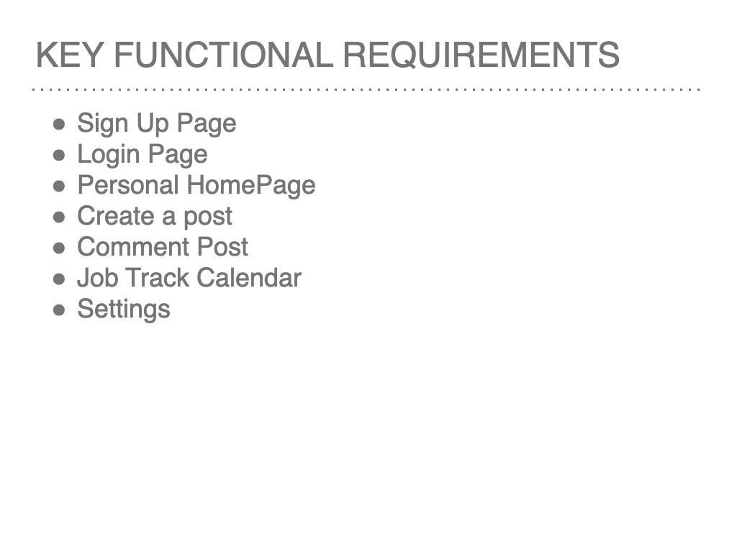
KEY FUNCTIONAL REQUIREMENTS
Sign Up Page
Login Page
Calendar
Task Creation Modal
Task Tracker
Task Tracker Timer
Settings
Notes:
rebecca

Slide 4
KEY FUNCTIONAL REQUIREMENTS
Sign up page
Description:
User can enter their own personal information to create an account.
Priority: 0

Slide 5
KEY FUNCTIONAL REQUIREMENTS
Login Page
Description:
User can enter their own usernames and passwords to log in.
Priority: 0

Slide 6
KEY FUNCTIONAL REQUIREMENTS
Personal HomePage
Description:
A fancy web page showing users' personal information.
Priority: 0

Slide 7
KEY FUNCTIONAL REQUIREMENTS
create a post
Description:
User publish their own post after they log in.
Priority: 0

Slide 8
KEY FUNCTIONAL REQUIREMENTS
Comment
Description:
Users can reply the posts after log in.
Priority: 1

Slide 9
KEY FUNCTIONAL REQUIREMENTS
Job track calendar
Description:
Each user has their own job calendar, showing the picked companies timeline.
Priority: 2

Slide 10
KEY NON-FUNCTIONAL REQUIREMENTS
Password Recovery
Message Notice
Like the post
Report junk post

Slide 11
KEY NON-FUNCTIONAL REQUIREMENTS
Password Recovery
Description:
This is for the user when they do not remember their password.
Priority: 1
Applicable FR: Login page
Notes:
jordan

Slide 12
KEY NON-FUNCTIONAL REQUIREMENTS
Message Notice
Description:
It will notify users to see new replies and other related stuff
Priority: 1
Applicable FR: Post
Notes:
jordan

Slide 13
KEY NON-FUNCTIONAL REQUIREMENTS
Like the post
Description:
This is for user to like a post.
Priority: 1
Applicable FR: Post
Notes:
jordan

Slide 14
KEY NON-FUNCTIONAL REQUIREMENTS
Report junk post
Description:
User can report the junk posts. Administrator will check reported posts and delete from backend.
Priority: 1
Applicable FR: Post
Notes:
jordan

Slide 15
SYSTEM CONSTRAINT
Deployment constraint
We need a remote server for our website.
Budget constraint
Fees of server.
Fees of CDN.
Device constraint
First on pc, then on mobile
Language constraint
It will support both EN and CN

Slide 16
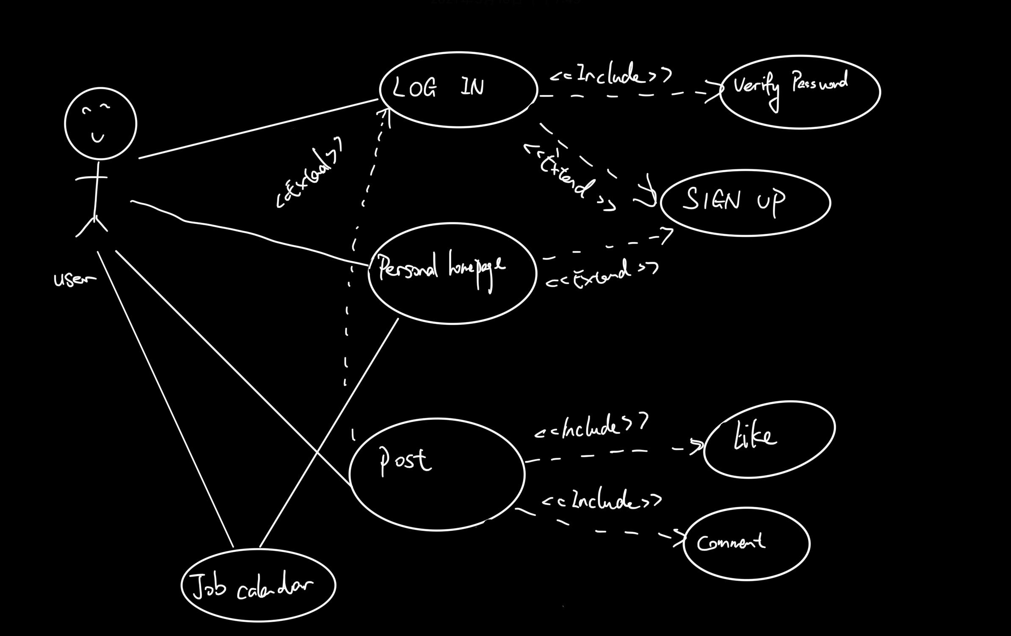
USE CASE DIAGRAM
Notes:
noah

Slide 17
EVOLUTIONARY REQUIREMENTS
charge requirement
Automatically detect junk comment and post
User’s own blog

Slide 18
If you have any questions, just leave a message on slack!
Thank you!
----Team12

